Slide 1
Object-Oriented Programming
Mr. Ali Haider
Lab Instructor
School of CS & IT
Institute of Management Sciences, Peshawar, Pakistan

Slide 2
Aim of the course
This course provides
In depth knowledge of the various concepts of object oriented programming
Implementation of various concepts of Object Oriented Programming in C++
Text book
C++ How to program by Deitel and Deitel
Reference books
Waite Group’s Object oriented programming in C++, Robert Lafore

Slide 3
Introduction
Class and Object are fundamental concepts of OOP, while Encapsulation, Abstraction, Inheritance, and Polymorphism are the four pillars (main principles) of OOP.
Class and Object are the basic building blocks of OOP - they're the foundation you need before you can even talk about the pillars. But they are not the pillars themselves.
Class = a blueprint/template (defines attributes and methods)
Object = an actual instance created from that class (real entity in memory)

Slide 4
Simple DAILY LIFE Examples TO UNDERSTAND BASIC CONCEPTS OF OOP
You are driving a car
You can press accelerator pedal to increase the speed.
You can press the brake pedal to stop or decrease the speed.
You can turn the steering wheel to turn the car left or right
Someone has design it first and then built it
Engineering drawings → car
Drawings also includes design for accelerator pedal to make car go faster
We can say, pedal “hides” complex mechanism that make the car go faster
The gear lever “hides” the complex internal mechanism of the car to shift gears.
The brake pedal “hides” the complex internal mechanism of the car to stop or decrease the speed.
The steering wheel “hides” complex mechanism of the car to turn right or left

Slide 5
Brake pedal “hides” the mechanism that slows the car
Steering wheel “hides” the mechanism that turn the car and so on
Simple “interfaces” like accelerator and brake pedal, steering wheel, transmission shift and etc. allow driver to interact car’s complex internal mechanisms

Slide 6
Points to be noted
You cannot drive the engineering design of a car
Before you can drive a car, it must be built according to engineering design
The car will not accelerator on its own, a driver must press the accelerator pedal
In simpler words there has to be a car to use its functionalities

Slide 7
Object
Look around right now and you'll find many examples of real-world objects:
your dog, your desk, your television set, your bicycle.
Real-world objects share two characteristics: They all have
State and
Behavior

Slide 8
Example
Real-world objects vary in complexity
your desktop lamp may have only two possible states (on and off) and two possible behaviors (turn on, turn off),
but your desktop radio might have additional states (on, off, current volume, current station) and behavior (turn on, turn off, increase volume, decrease volume, seek, scan, and tune).

Slide 9
Class
In the real world, you'll often find many individual objects all of the same kind
There may be thousands of other bicycles in existence, all of the same make and model.
Each bicycle was built from the same engineering design and contains the same components.
In object-oriented terms, we say that your bicycle is an instance of the class of objects known as bicycles.

Slide 10
Class vs Object
Class is a blue print of an object, which is non-live entity.
Object is instance of class, which is a live entity.
Example:
Employee is a class
Fruit is a class
I am an object
apple is an object

Slide 11
POINTS TO REMEMBER
A class is not a living entity, it is just a engineering design that how an object of this class look like
Object are living entities

Slide 12
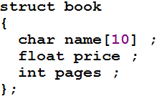
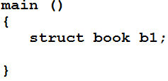
Struct
A struct in C++ can have constructors, destructors, member functions, access specifiers (private, protected, public), and even support inheritance - essentially everything a class can do. The only difference remains the default access level:
Struct: Public
Class: Private

Slide 13
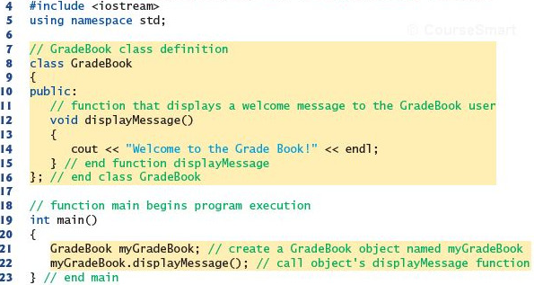
Class and Object

Slide 14
Data Member & Member Function
Data Member: Also known as Attribute, Feature.
A variable declared inside a class that holds the state/properties of an object. Represents "what the object has.”
Member Function (Method):
A function declared inside a class that defines the behavior of an object. Represents "what the object does."
Has access to the class's data members directly (no need to pass them as parameters).

Slide 15
Key Points
Each object gets its own copy of data members (e.g., c1's color and speed are separate from another Car object's).
Member functions are shared across all objects (not duplicated per object) - they operate on whichever object calls them, via the implicit this pointer.
Data members are typically kept private (encapsulation), and member functions are typically public to provide controlled access - this is where getters/setters come in, which we already covered.

Slide 16
The Dot (.) Operator
The dot operator (.) is used to access members (data members and member functions) of an object - but only when you have the actual object itself (not a pointer to it).
Syntax:
objectName.memberName; // access data member objectName.functionName(); // call member function

Slide 17
Enough for Today

Slide 18
Any Questions?

Slide 19
Thank You

